Slide 1
Jumper Man

Slide 2

Scene 1
History
SKIP

Slide 3


Scene 2
menu
start
options
exit

Slide 4
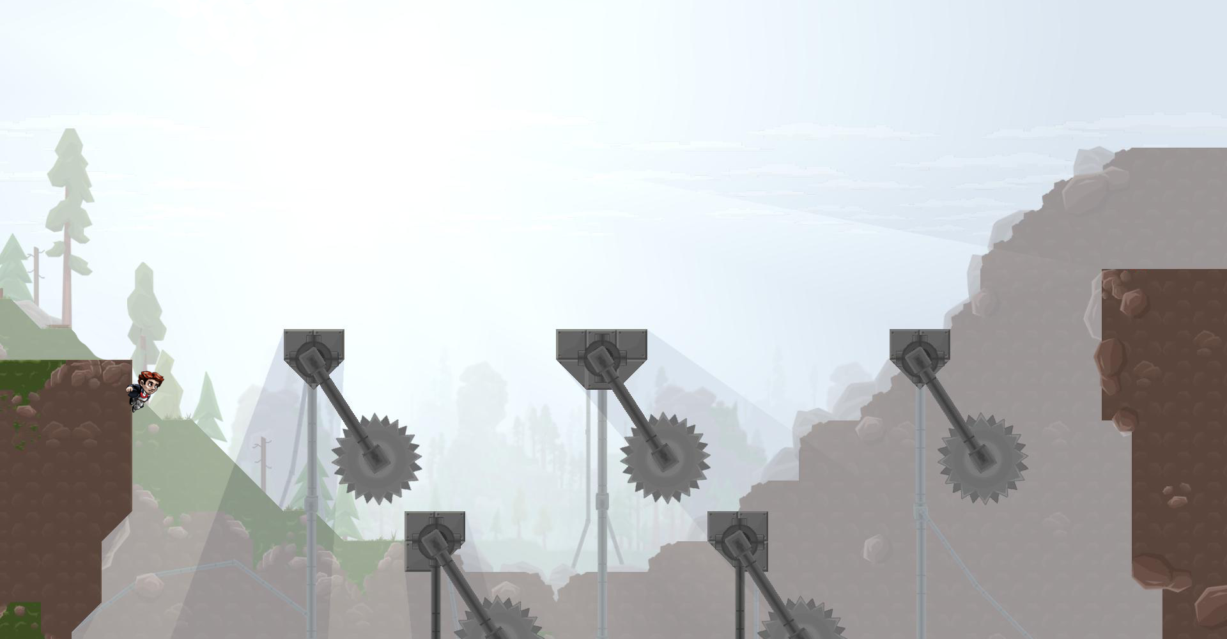
Scene 3
game
||
key 0 : 1
Time 00:00:00

